Slide 1
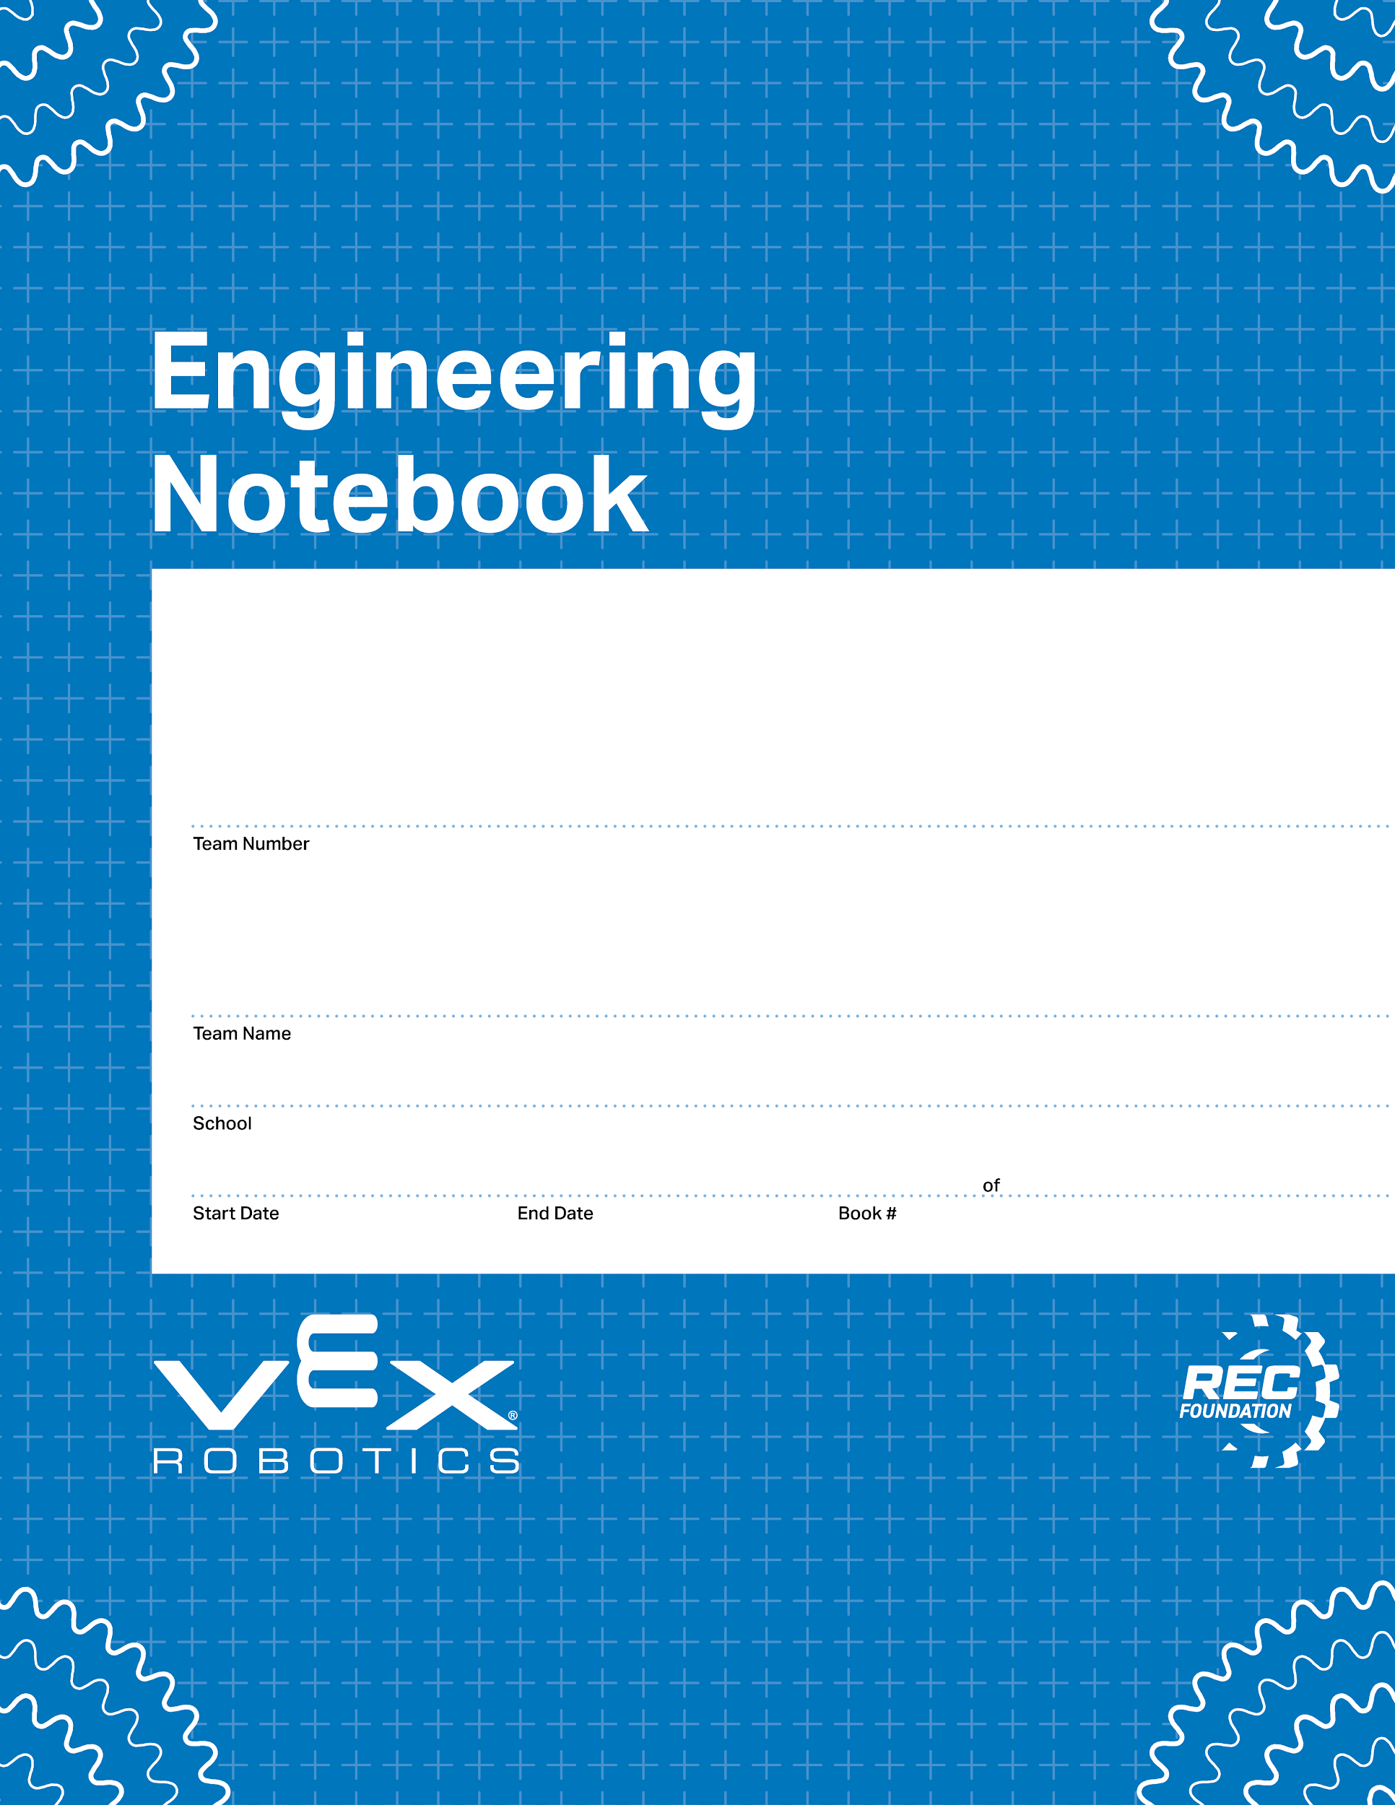
65544T
DynoBots
White Oak Elementary/Mills Park Middle
00/00/0000
00/00/0000
1
1
V3.0 Date 6.10.24

Slide 2
Notes
September: The scrimmage was on the 19th. -Deep

Slide 3
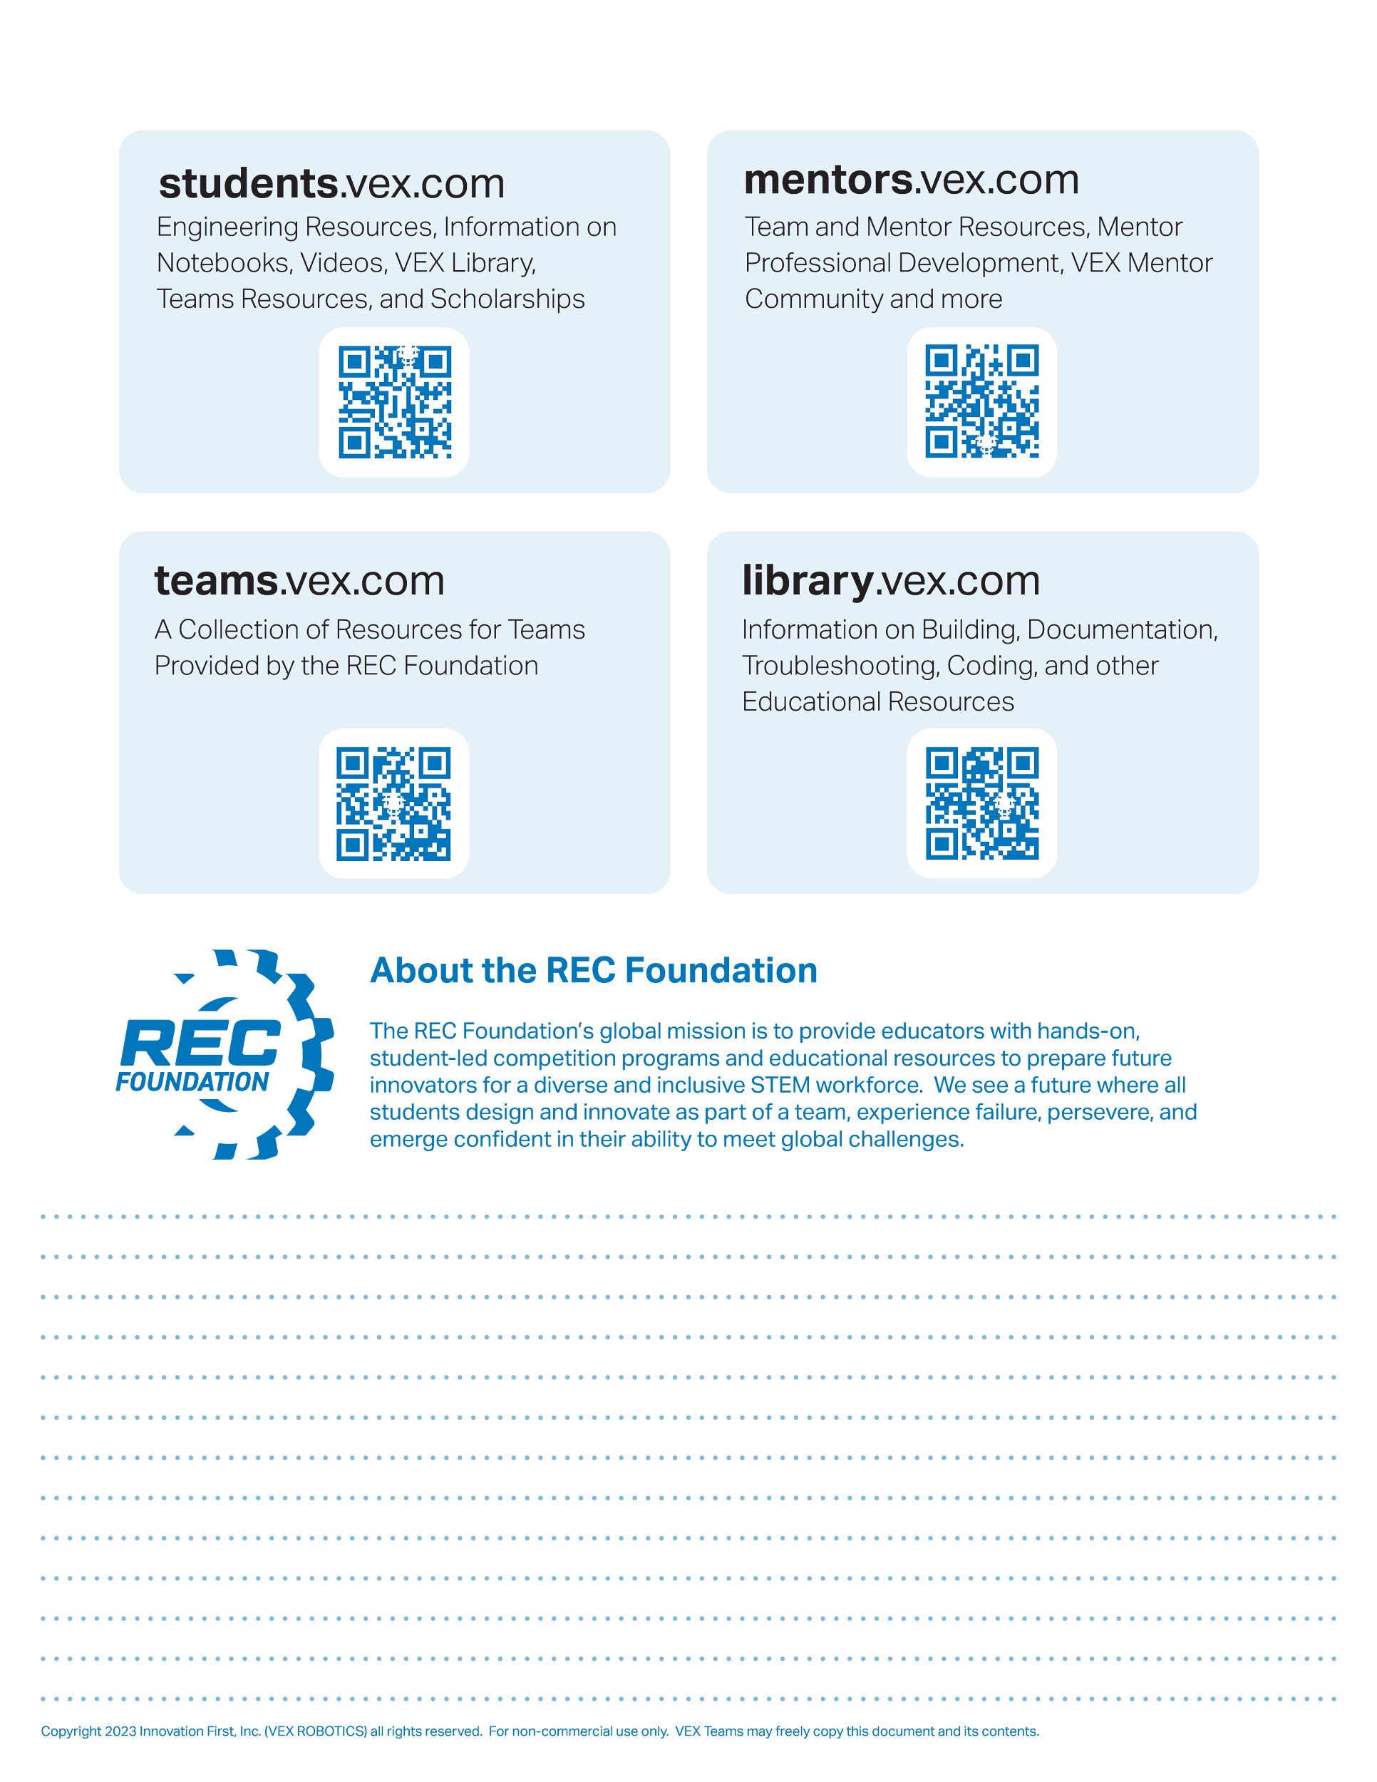
Resources
engineering.vex.com
notebooking.vex.com
coding.vex.com
Judging Rubric for Notebooks
vex.com
roboticseducation.org
VIQRC 2024-2025 Game - Rules & Game Video
Send suggestions and comments about these Digital Notebooks and Digital Parts
to notebooks@vex.com

Slide 4
12345 Title Title Title Date Date Date

Slide 5
Recap of August
In the month of August, we started building the board and the goals. We had different roles such as builder 1, builder 2, supply manager, and floater. On the first class, we quickly built the main board. Over the next classes in August, we started working on the switches and loading station. Since we had just started robotics, we scrambled for a tutorial to use to push us in the right direction. That is when we found the clawbot.

Slide 6
Recap of September
In the month of September, we finished the clawbot. However, we realized that the weight was to much to lift the ball. Then, on September 19th, we went to a local scrimmage and realized that this year's robo model was the swishbot. After noticing this, we immediately started our build on the swishbot.

Slide 7
Recap of October
In the month of October, it took us several classes to build the swishbot.

Slide 8
Recap of September
In the month of September, we finished the clawbot. However, we realized that the weight was to much to lift the ball. Then, on September 19th, we went to a local scrimmage and realized that this year's robo model was the swishbot. After noticing this, we immediately started our build on the swishbot.

Slide 9
Recap of September
In the month of September, we finished the clawbot. However, we realized that the weight was to much to lift the ball. Then, on September 19th, we went to a local scrimmage and realized that this year's robo model was the swishbot. After noticing this, we immediately started our build on the swishbot.

Slide 10
Section A

Slide 15
Roller
Port
Port
Port
Port
Port
Port
Port
Port
Port
Port
Port

Slide 16
Bumper
Bumper
Bumper
Bumper
Stick
Stick
Stick
Stick
Stick
Stick
Button
Button
Button
Button

Slide 17

“Rapid Relay” Game Field

Slide 18
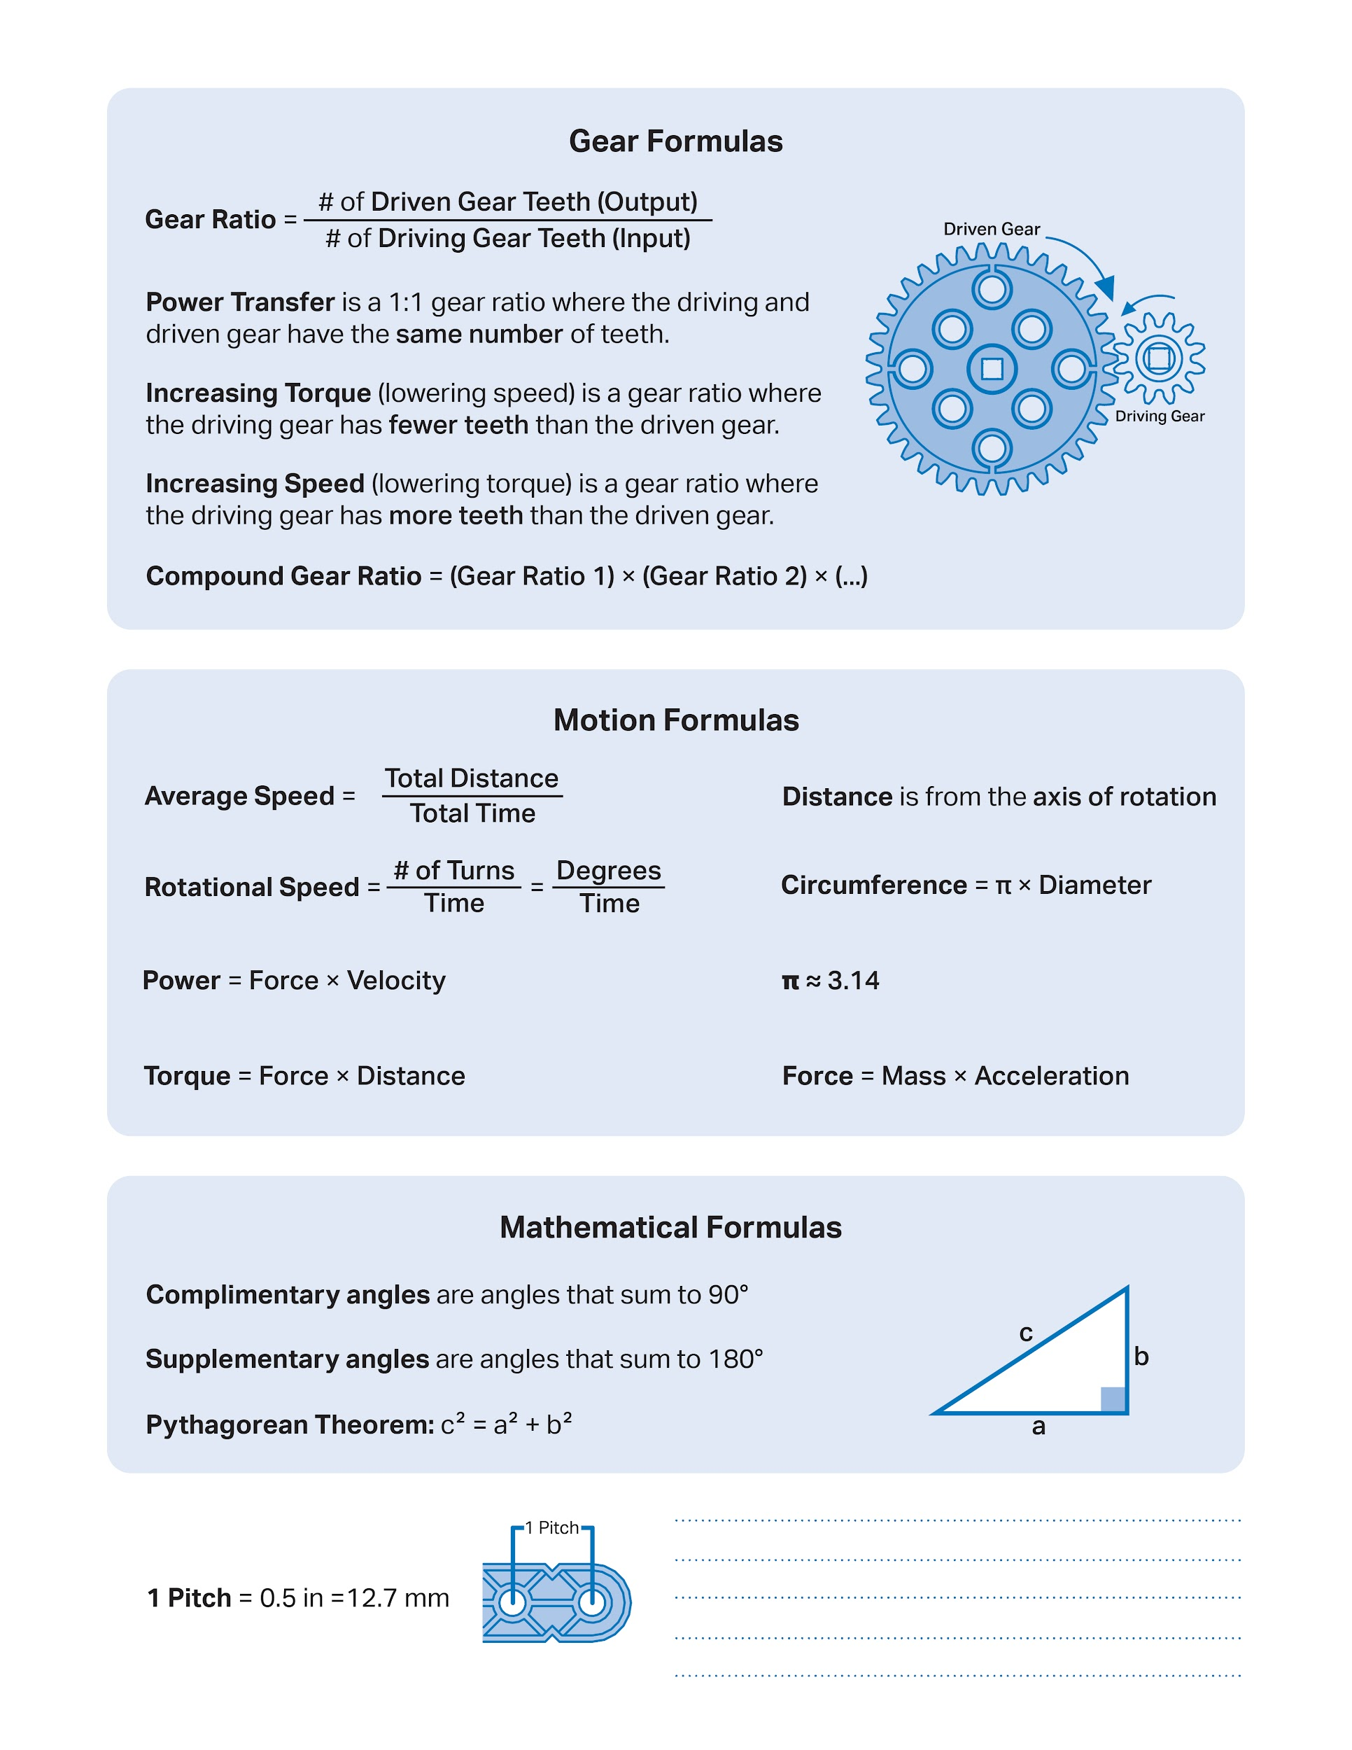

Slide 19
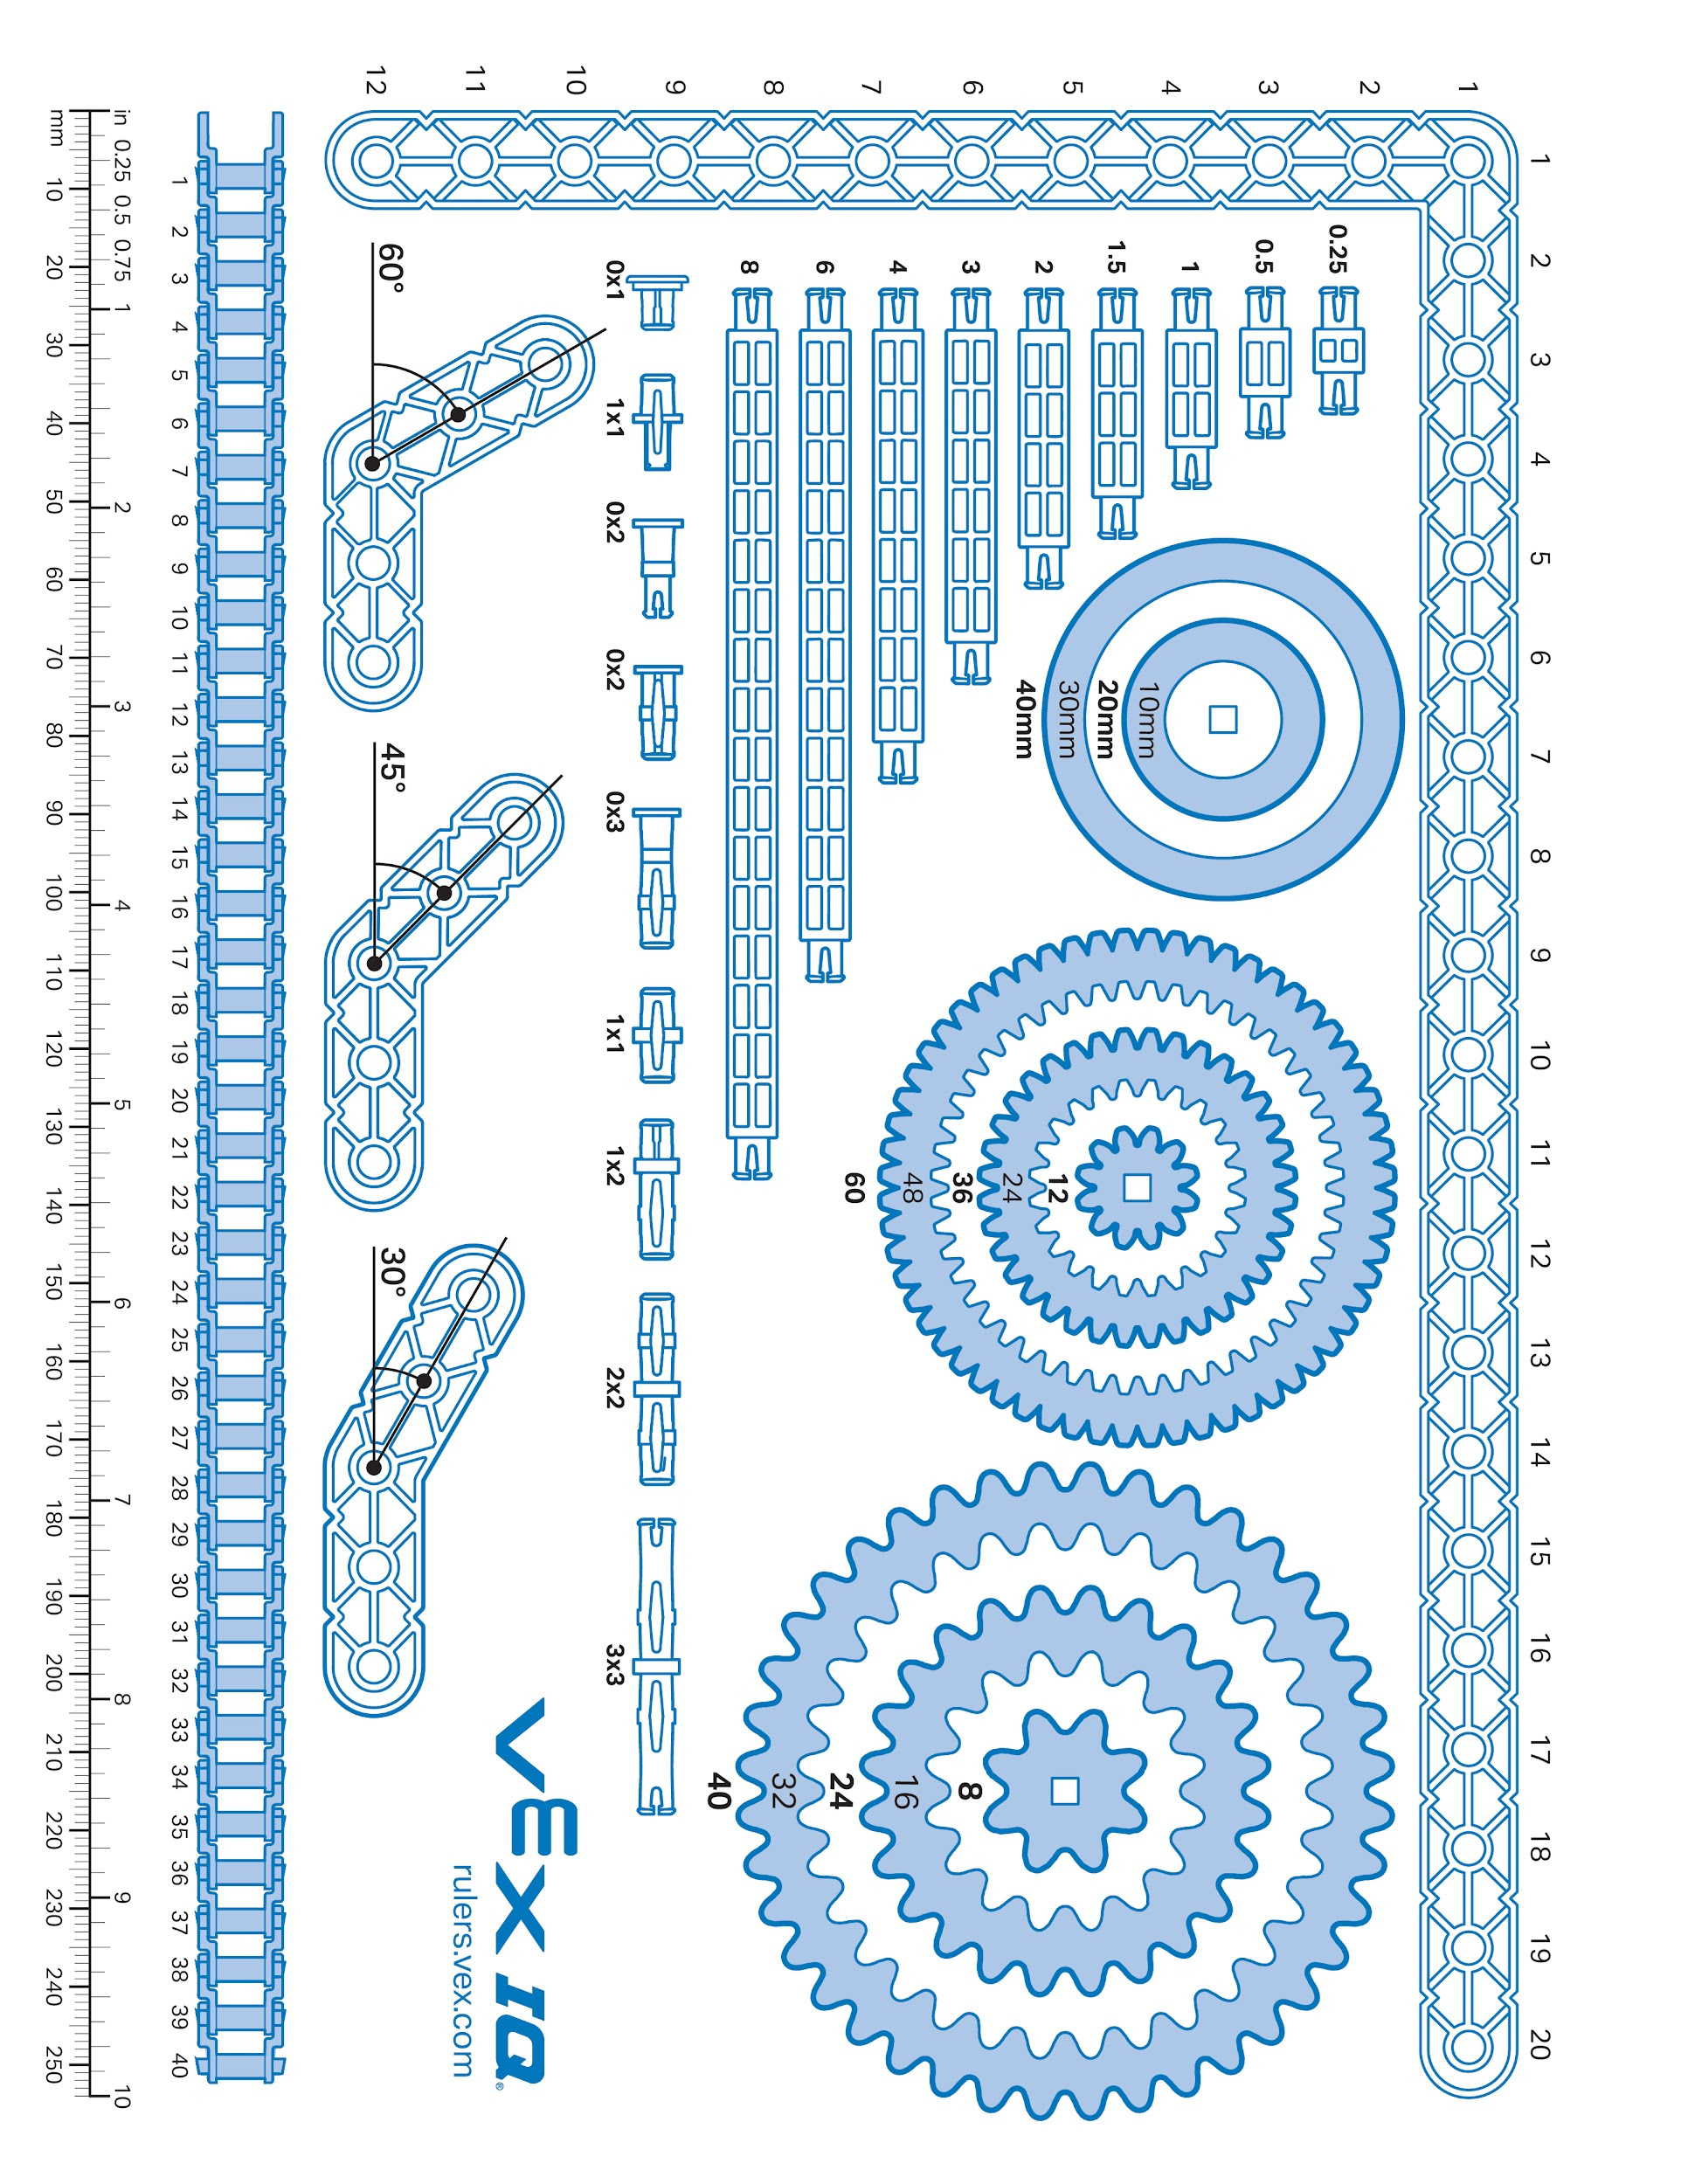

Slide 20
Week of: MM/DD/YYYY

Slide 21
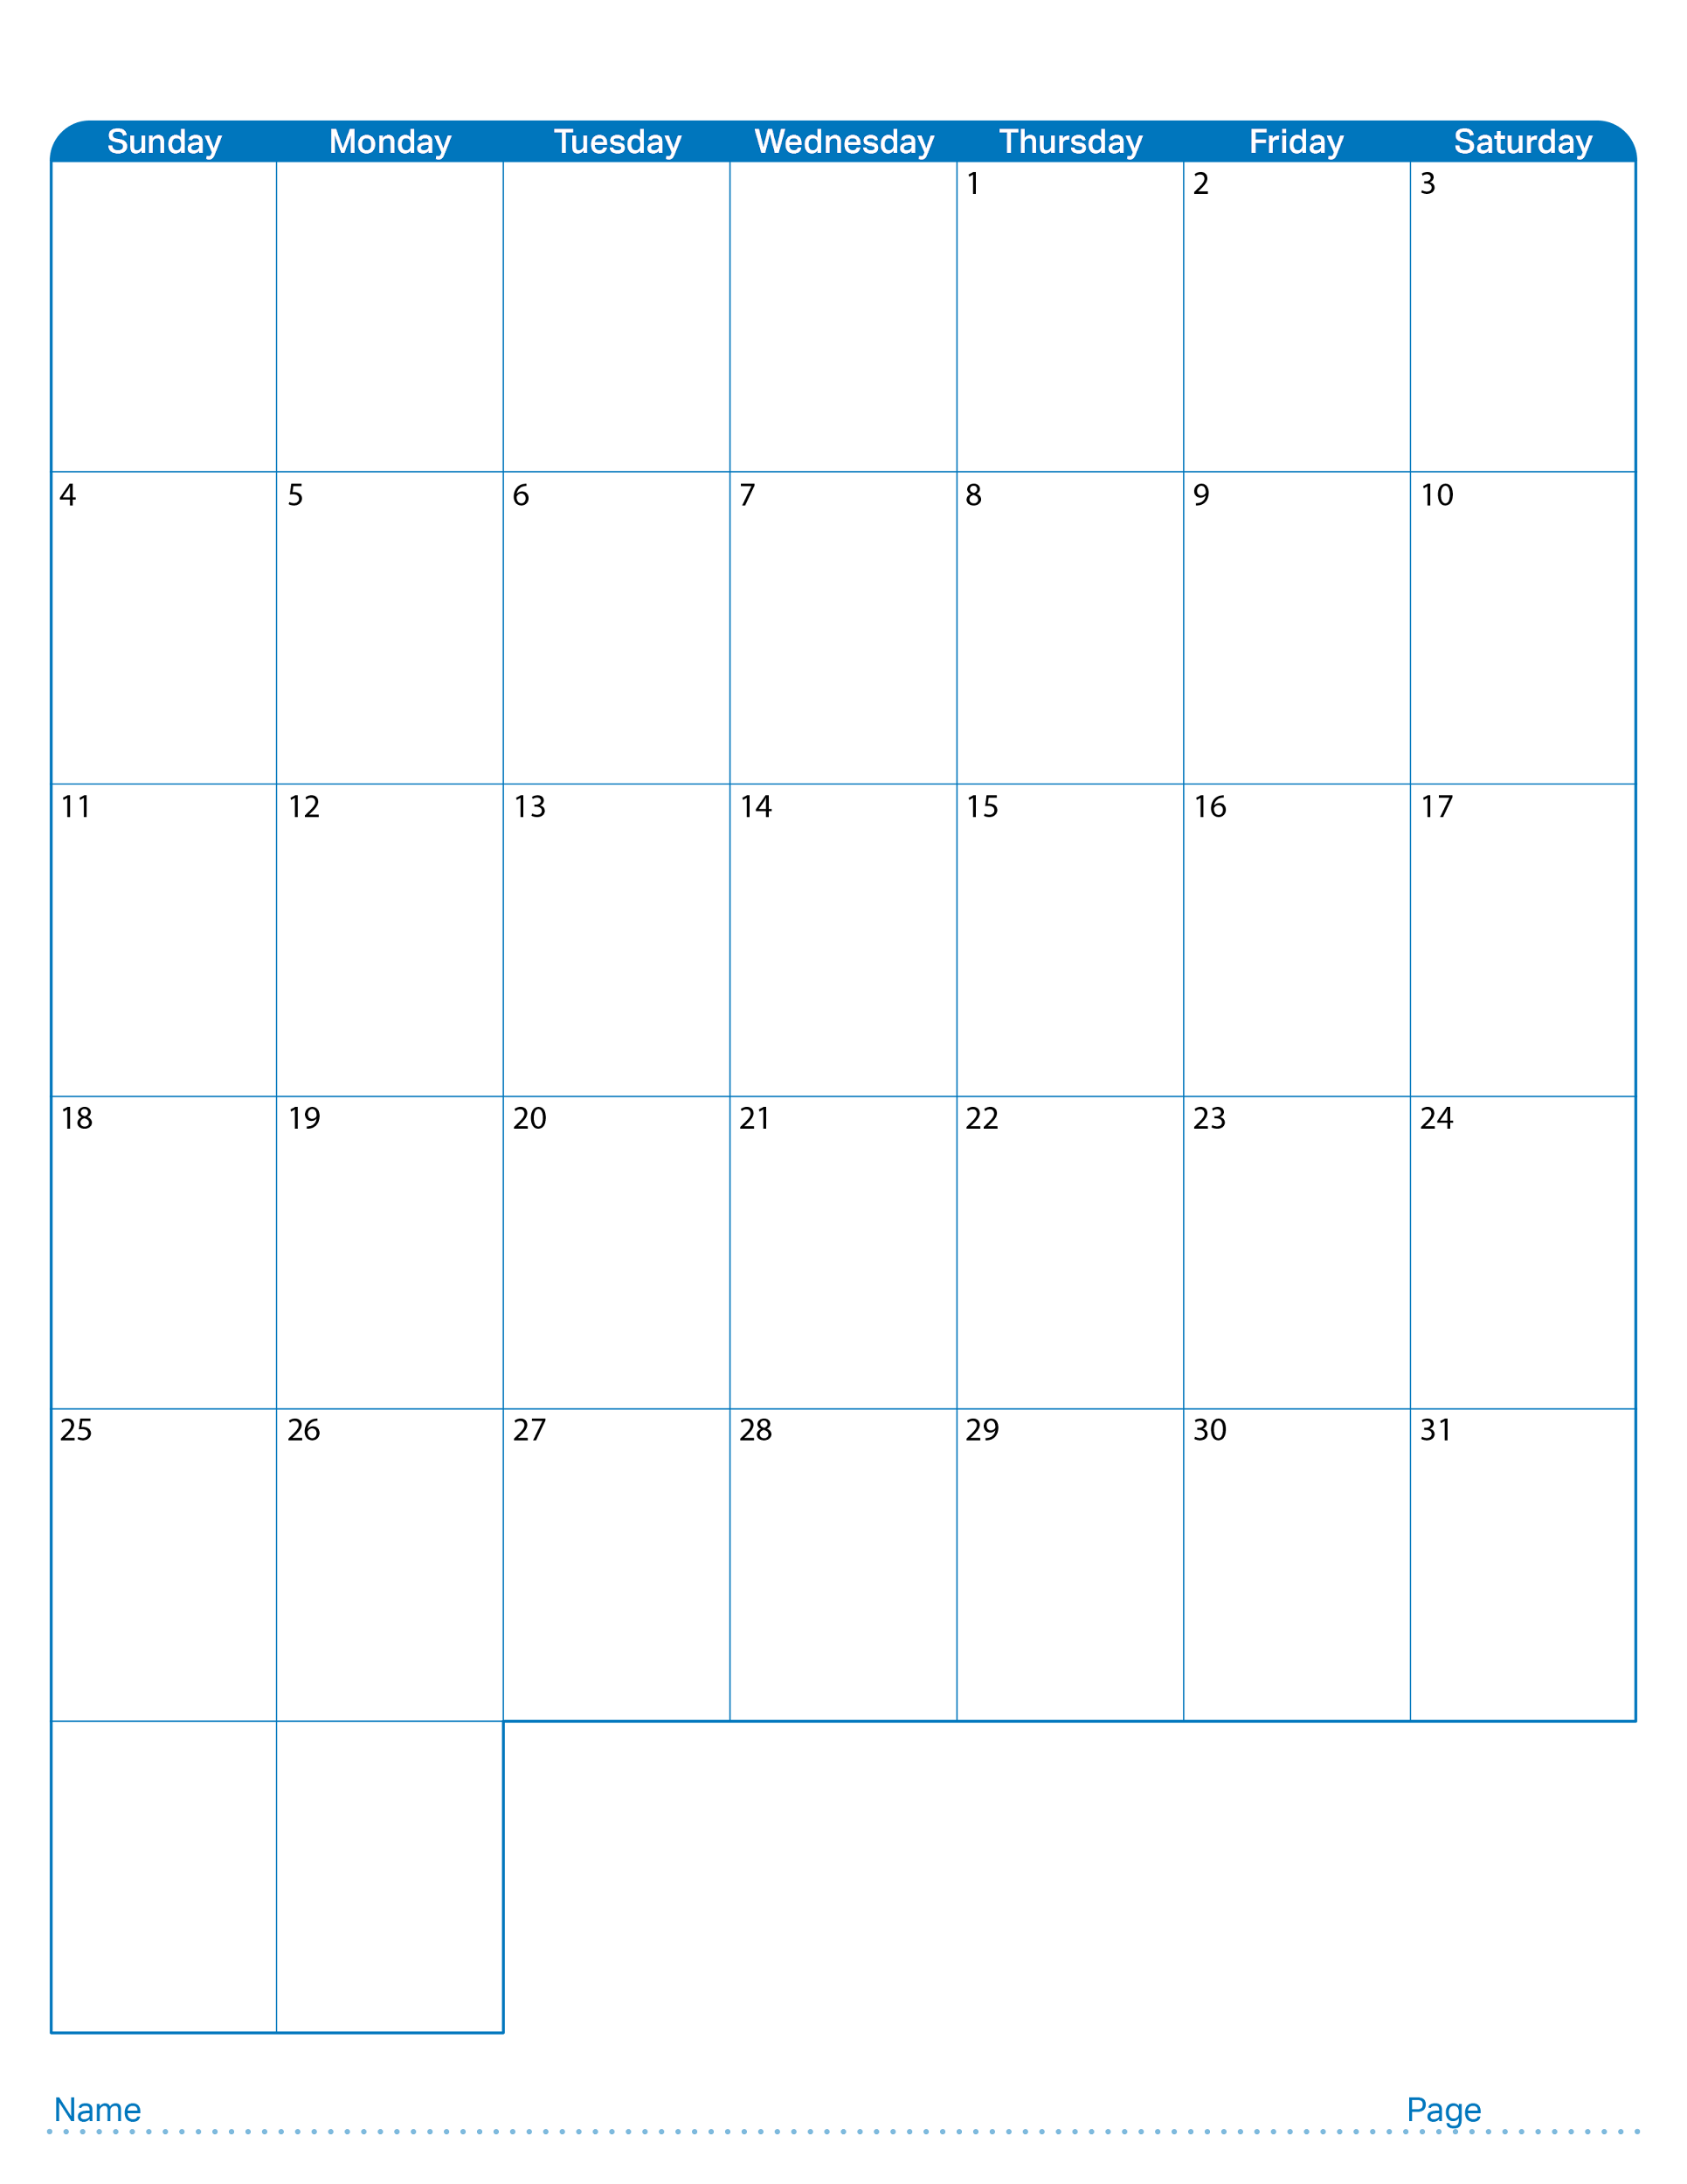
August 2024

Slide 22

September 2024

Slide 23
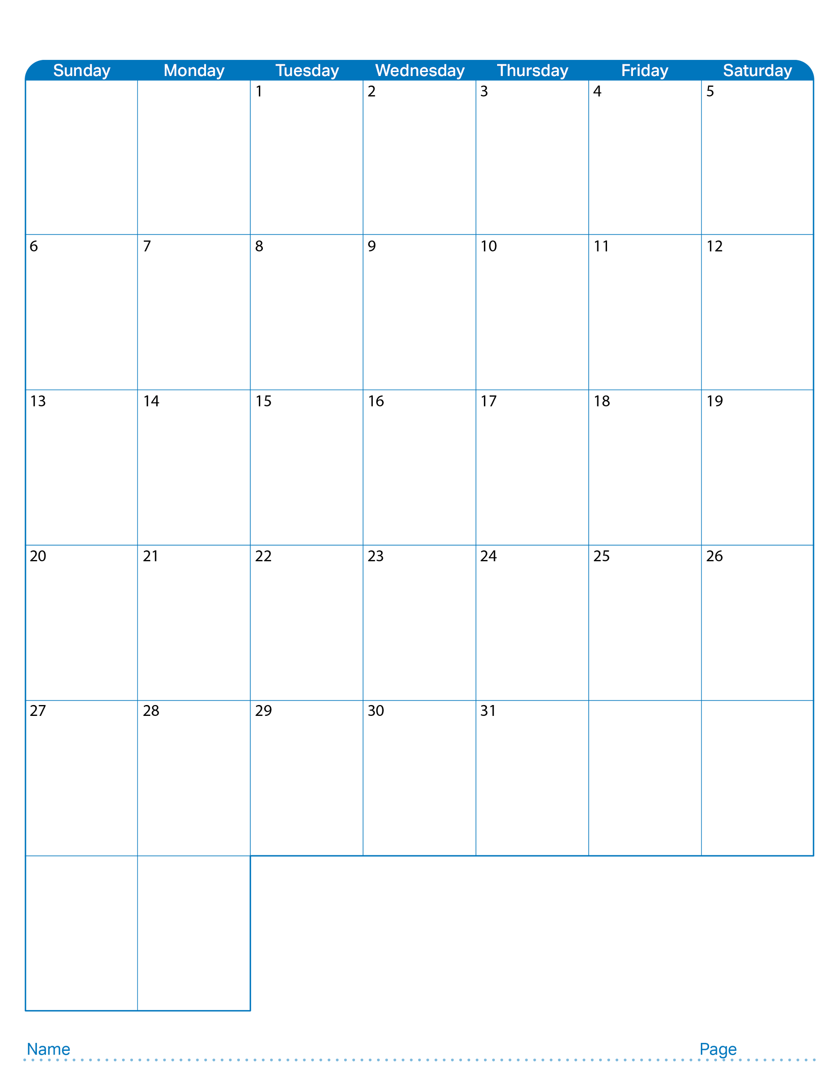
October 2024

Slide 24

November 2024

Slide 25

December 2024

Slide 26

January 2025

Slide 27

February 2025

Slide 28
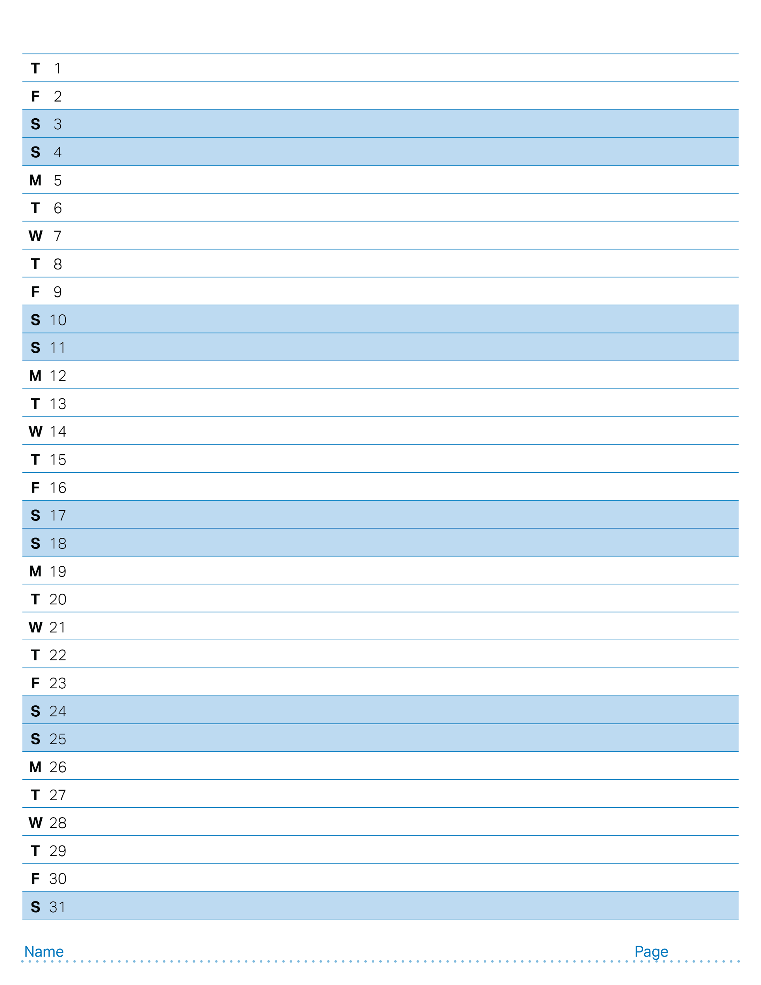
August 2024

Slide 29
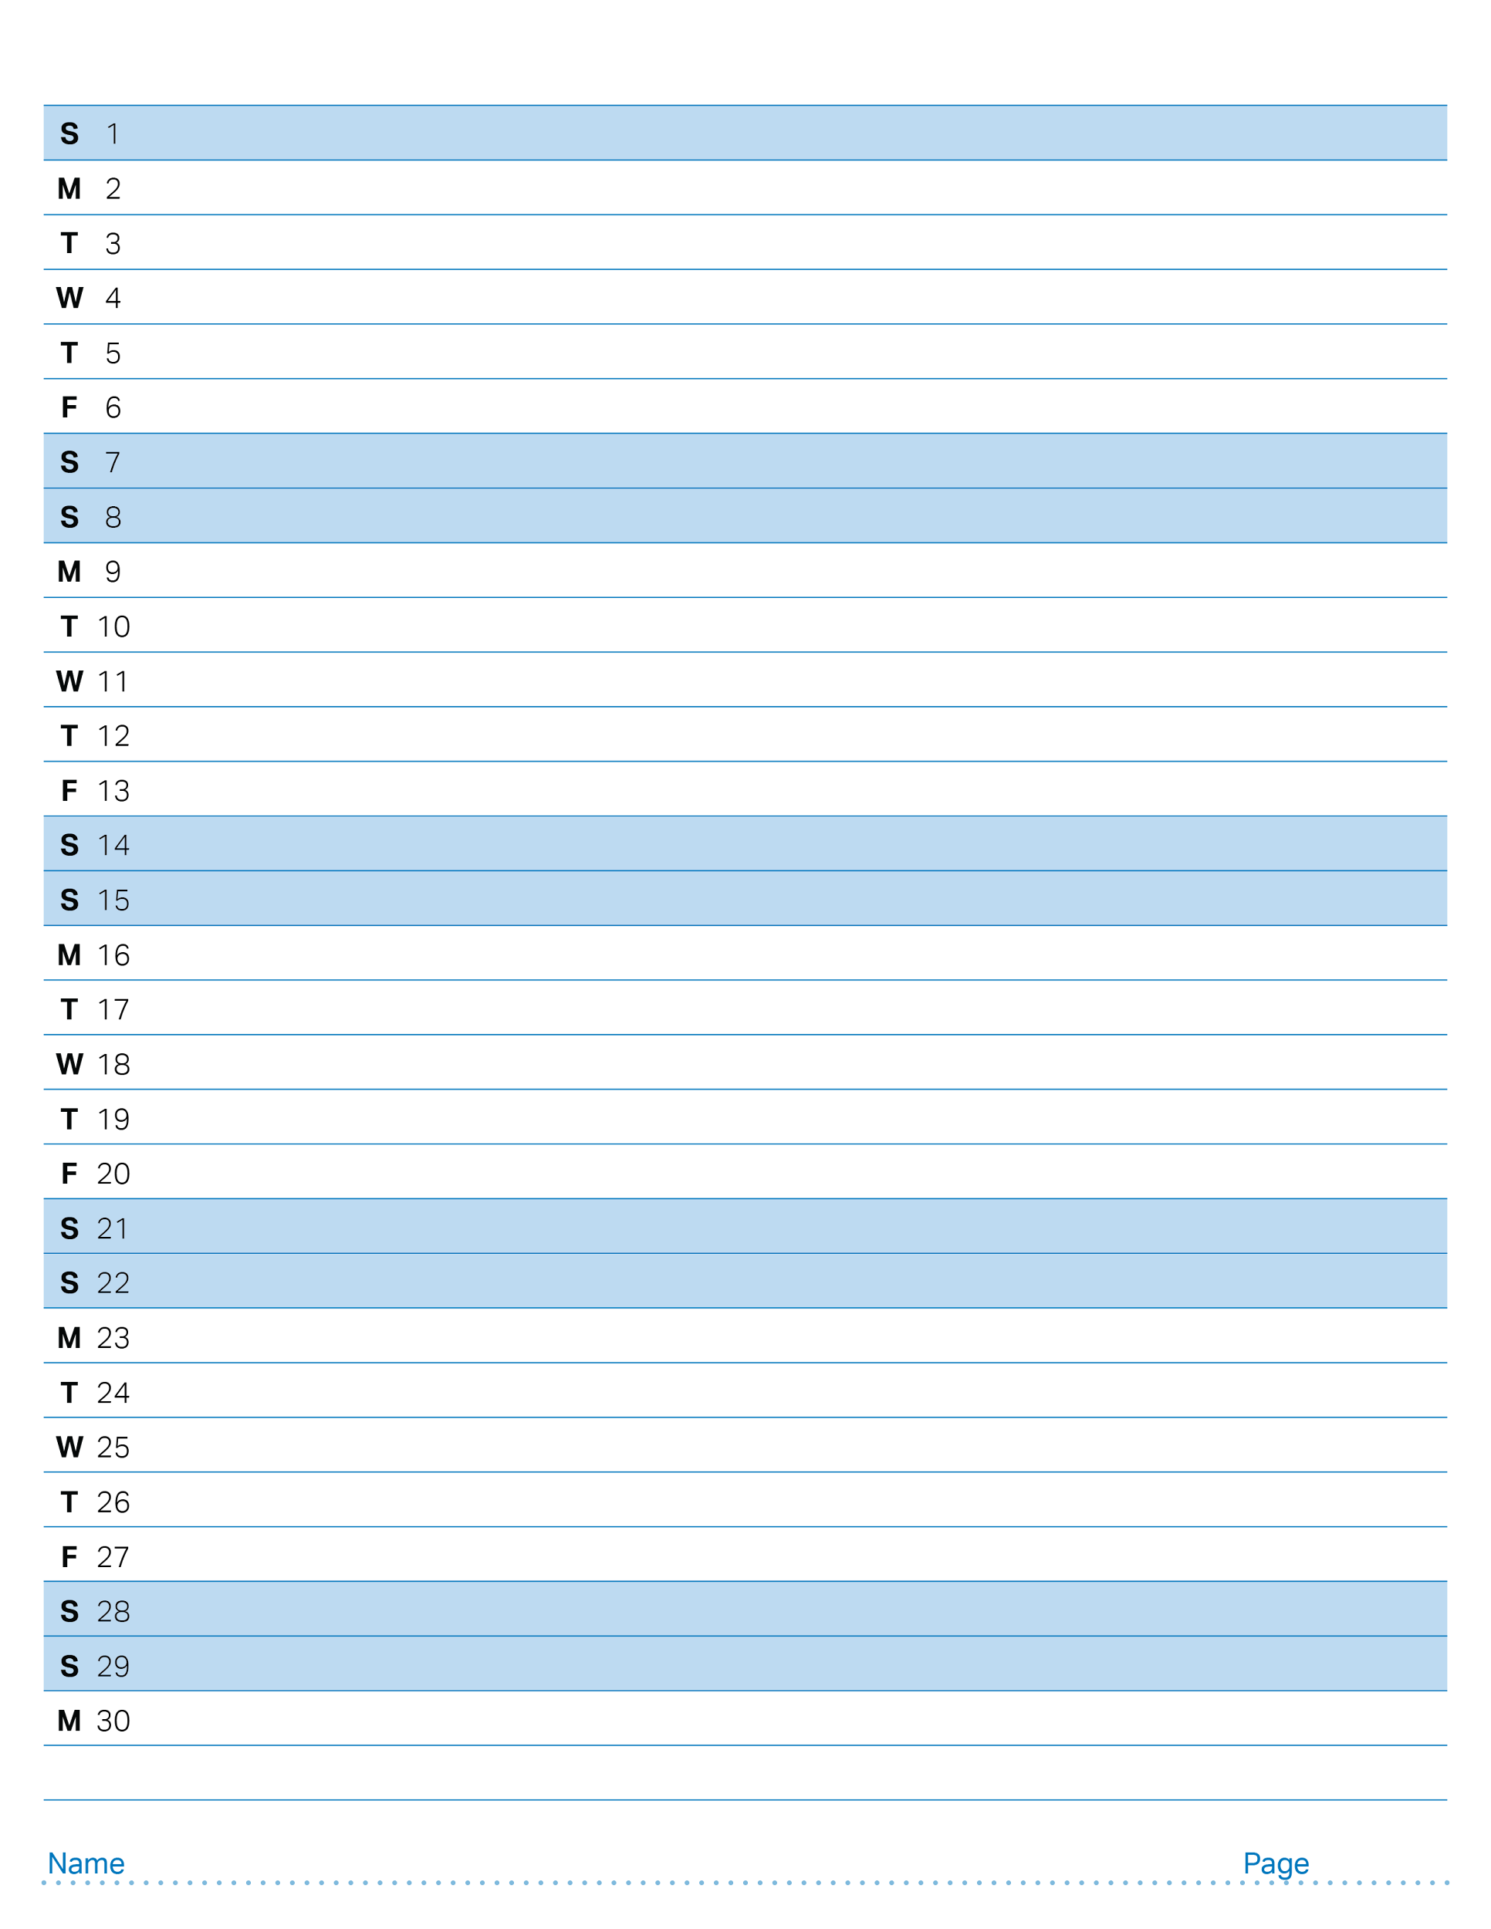
September 2024

Slide 30
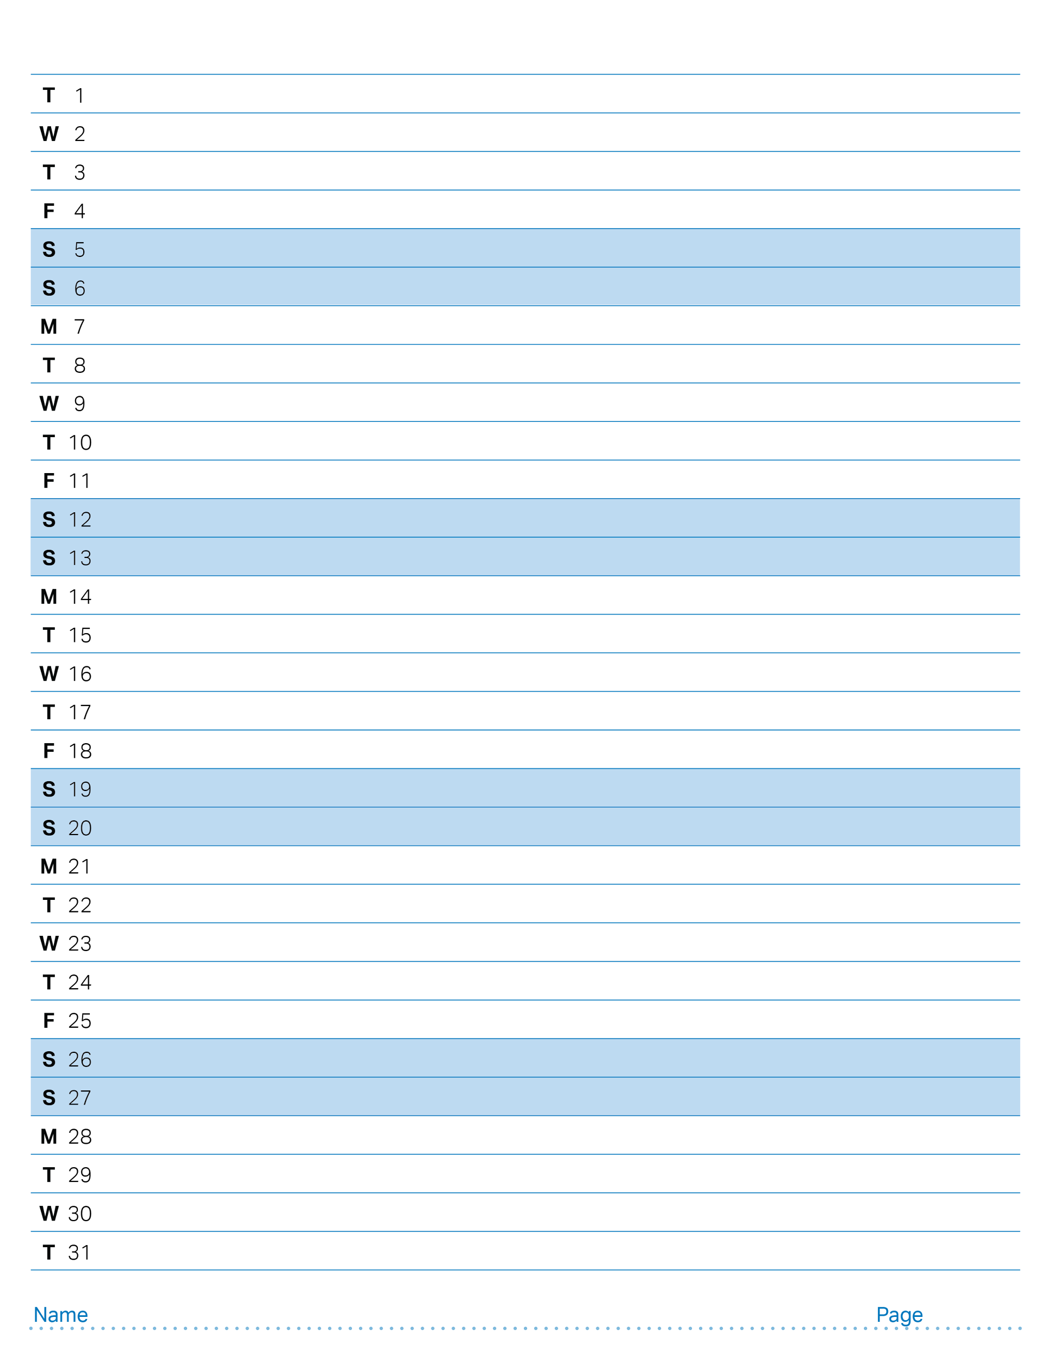
October 2024

Slide 31
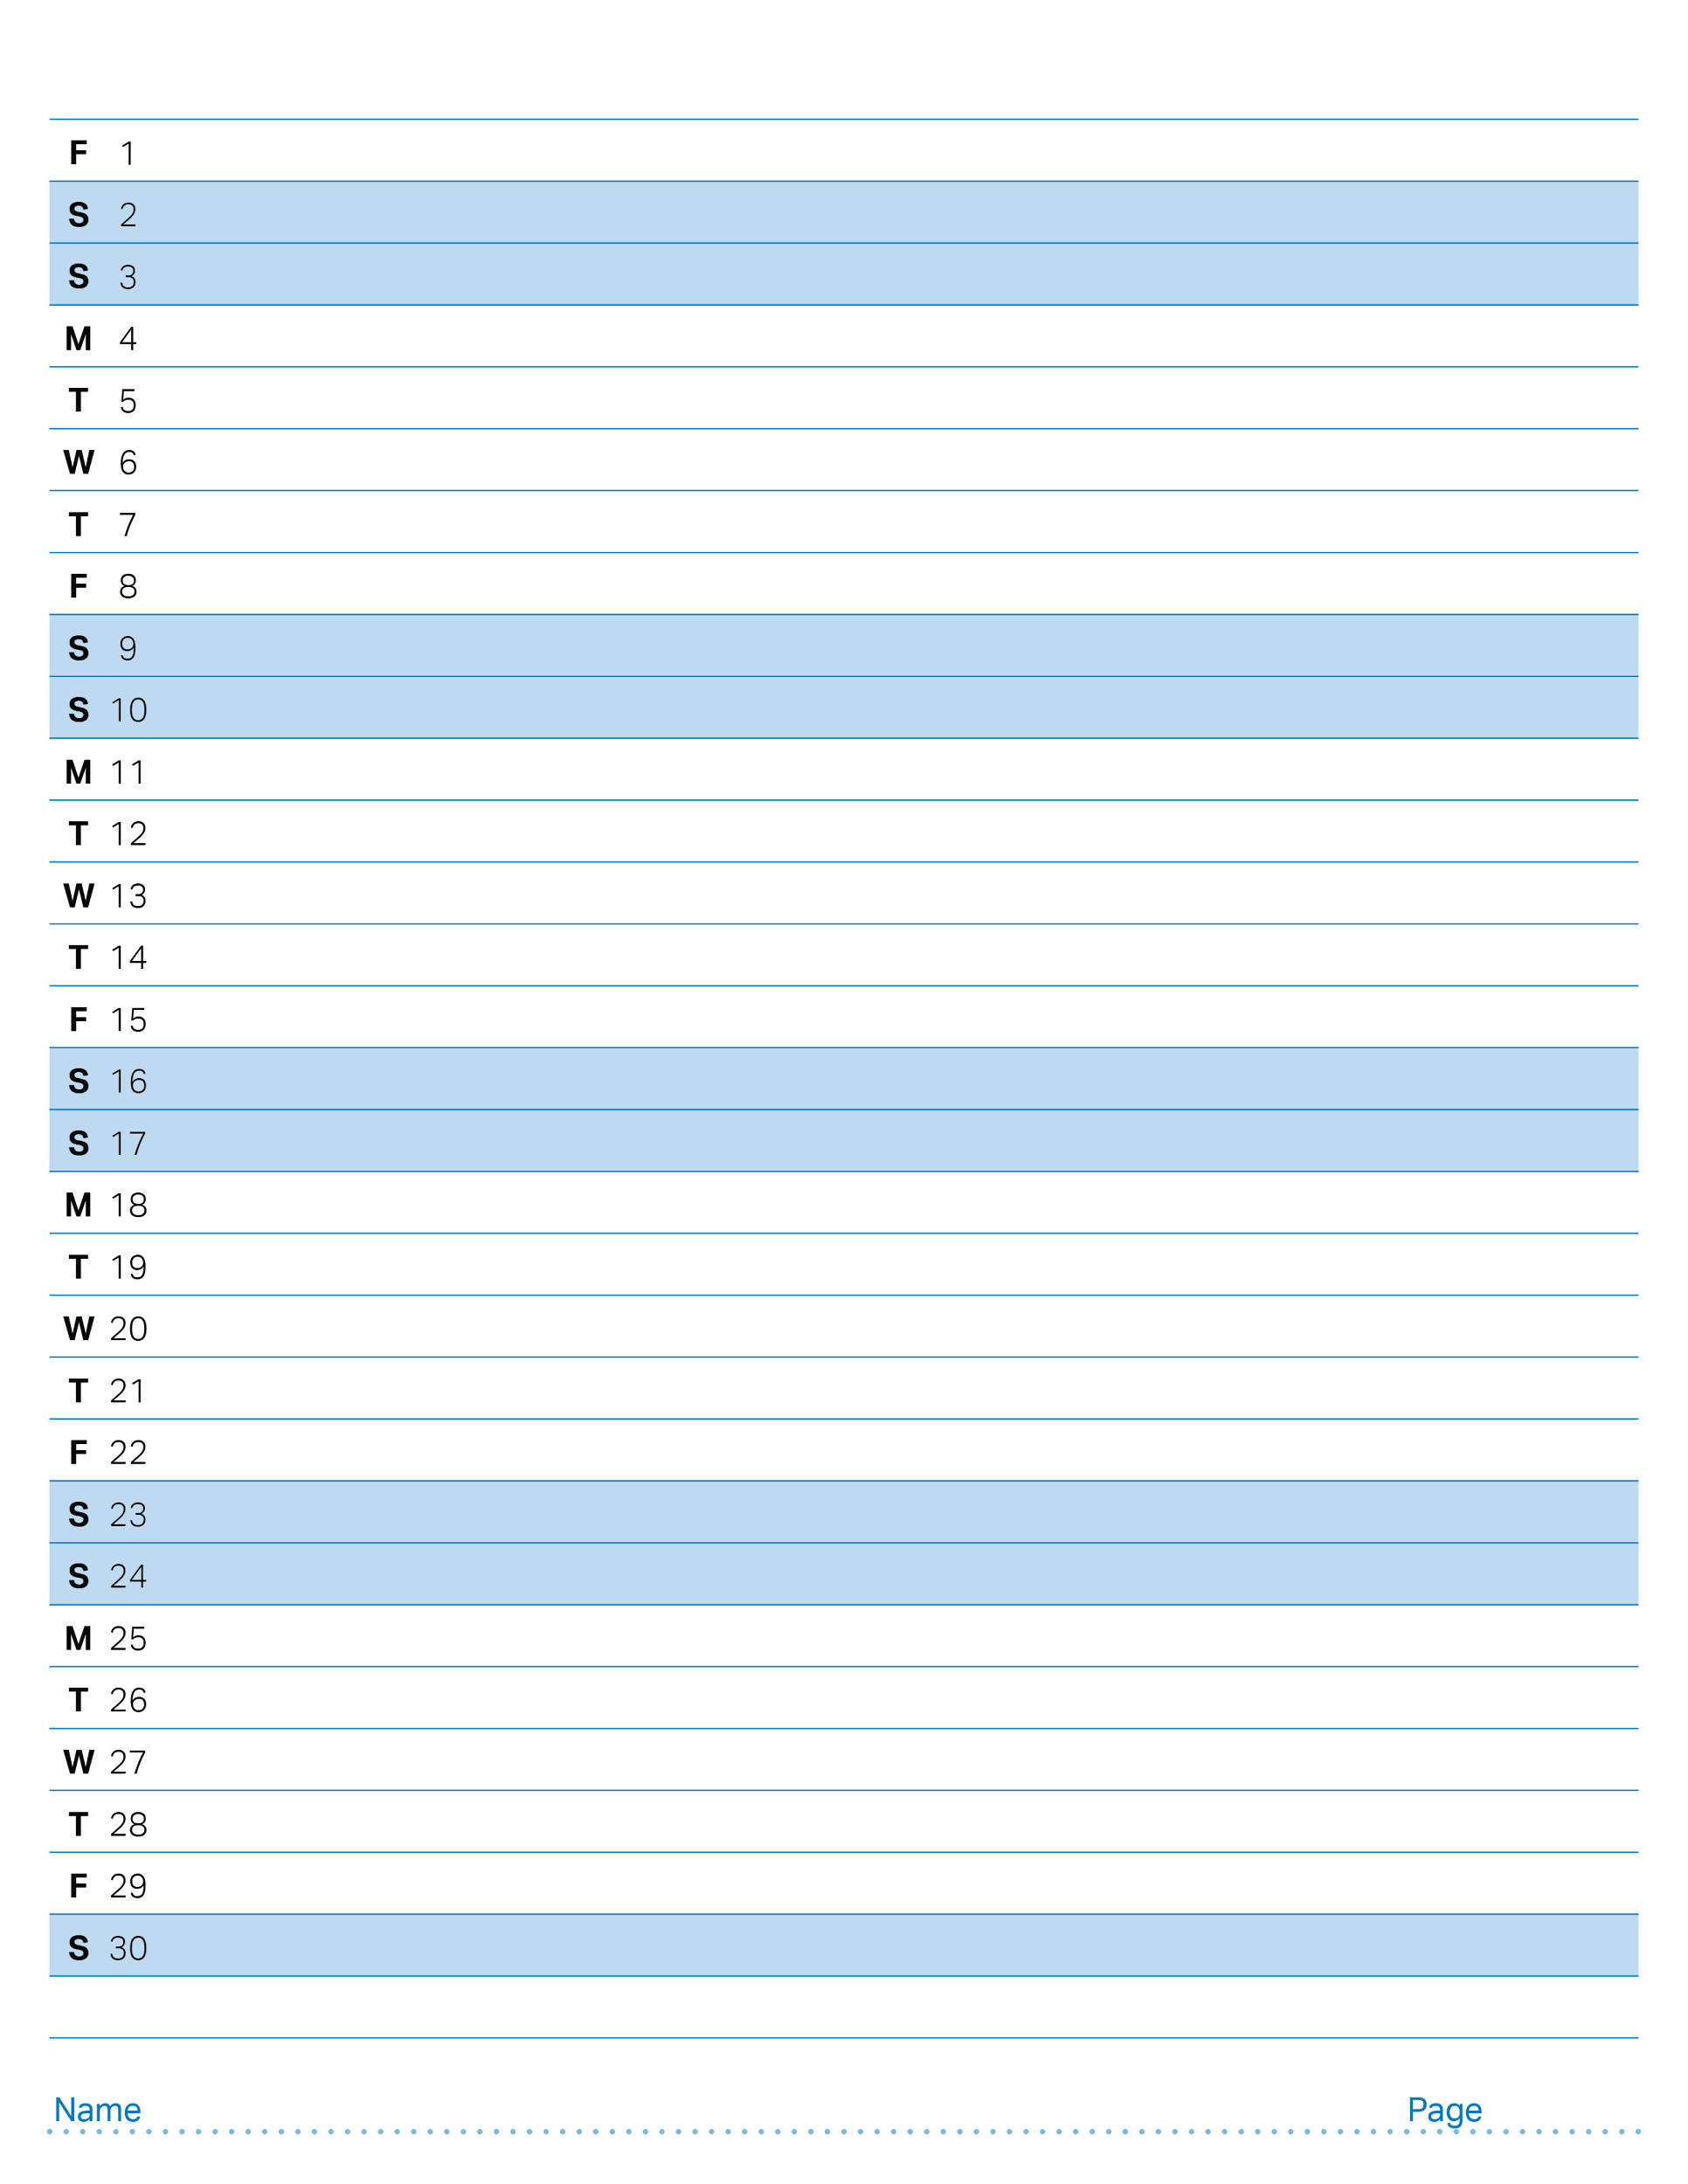
November 2024

Slide 32
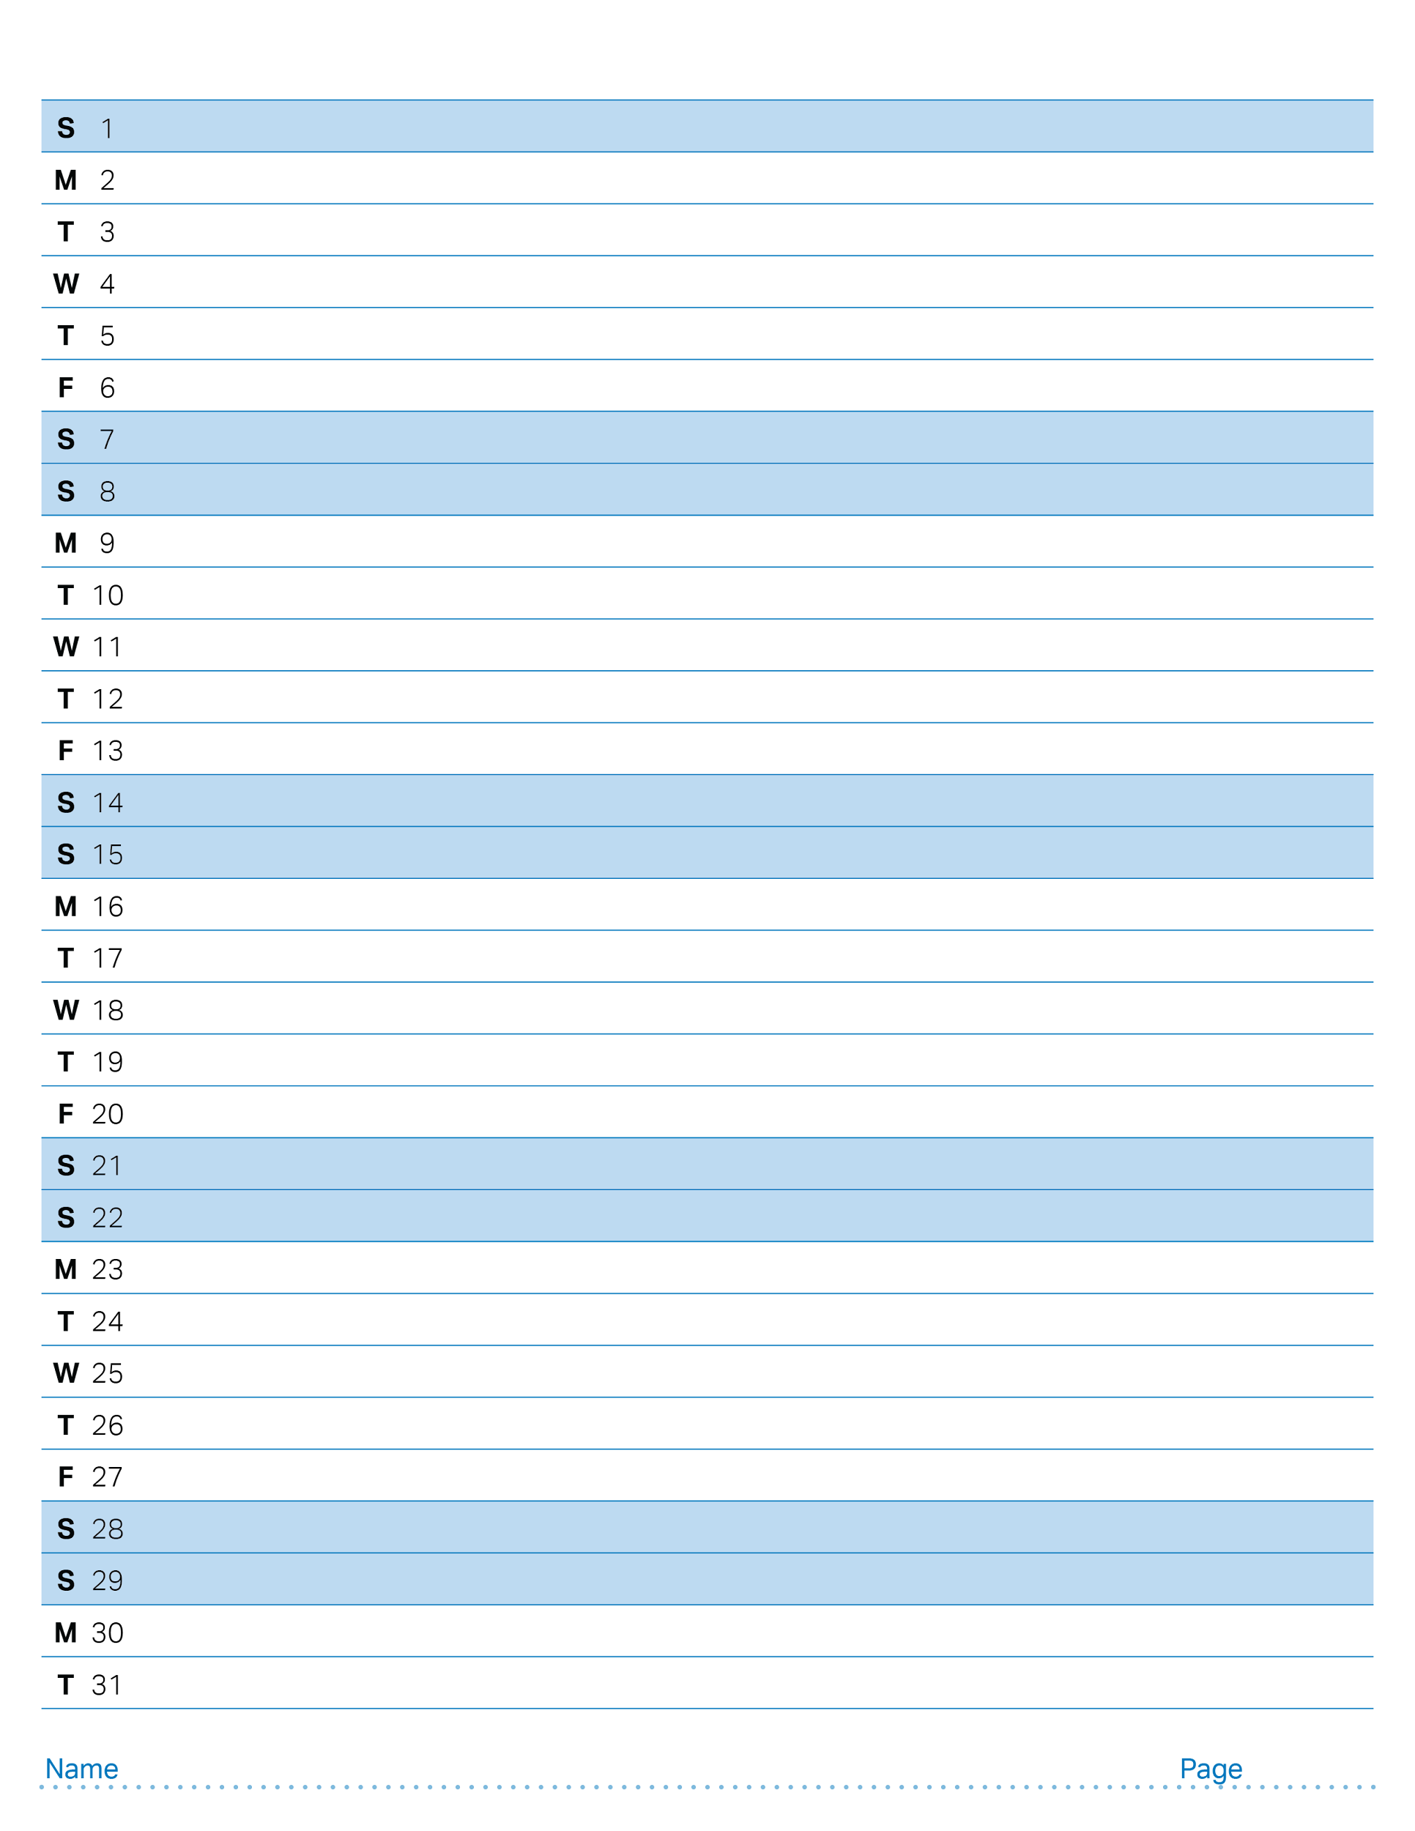
December 2024

Slide 33
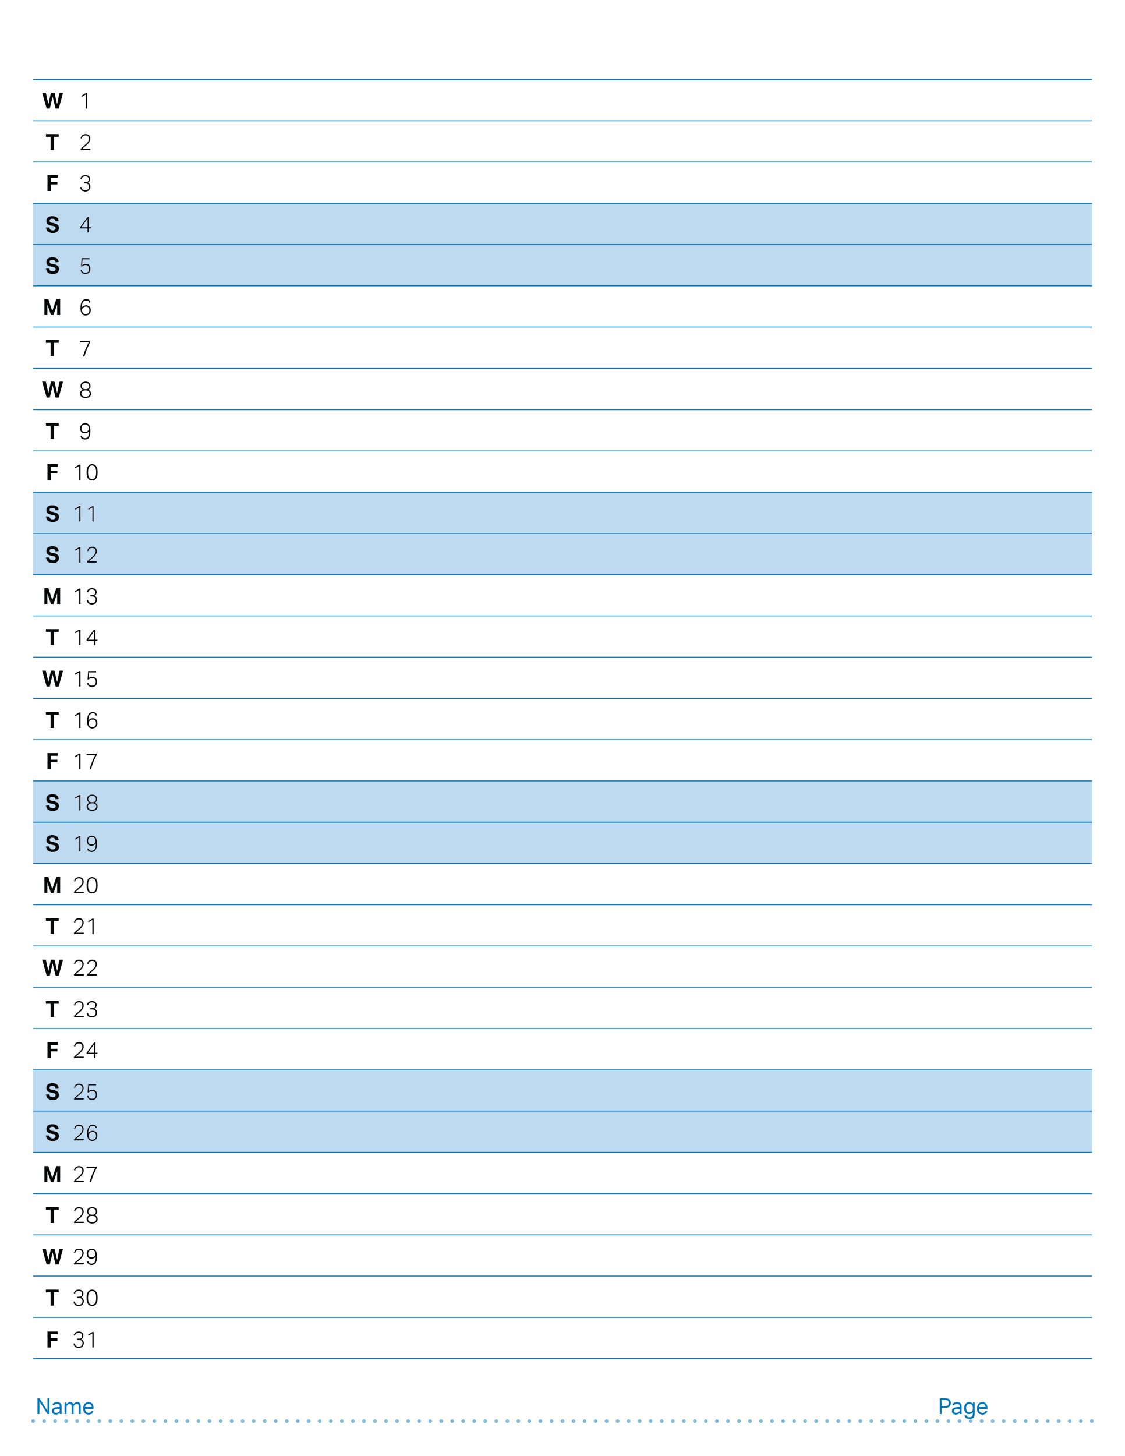
January 2025

Slide 34
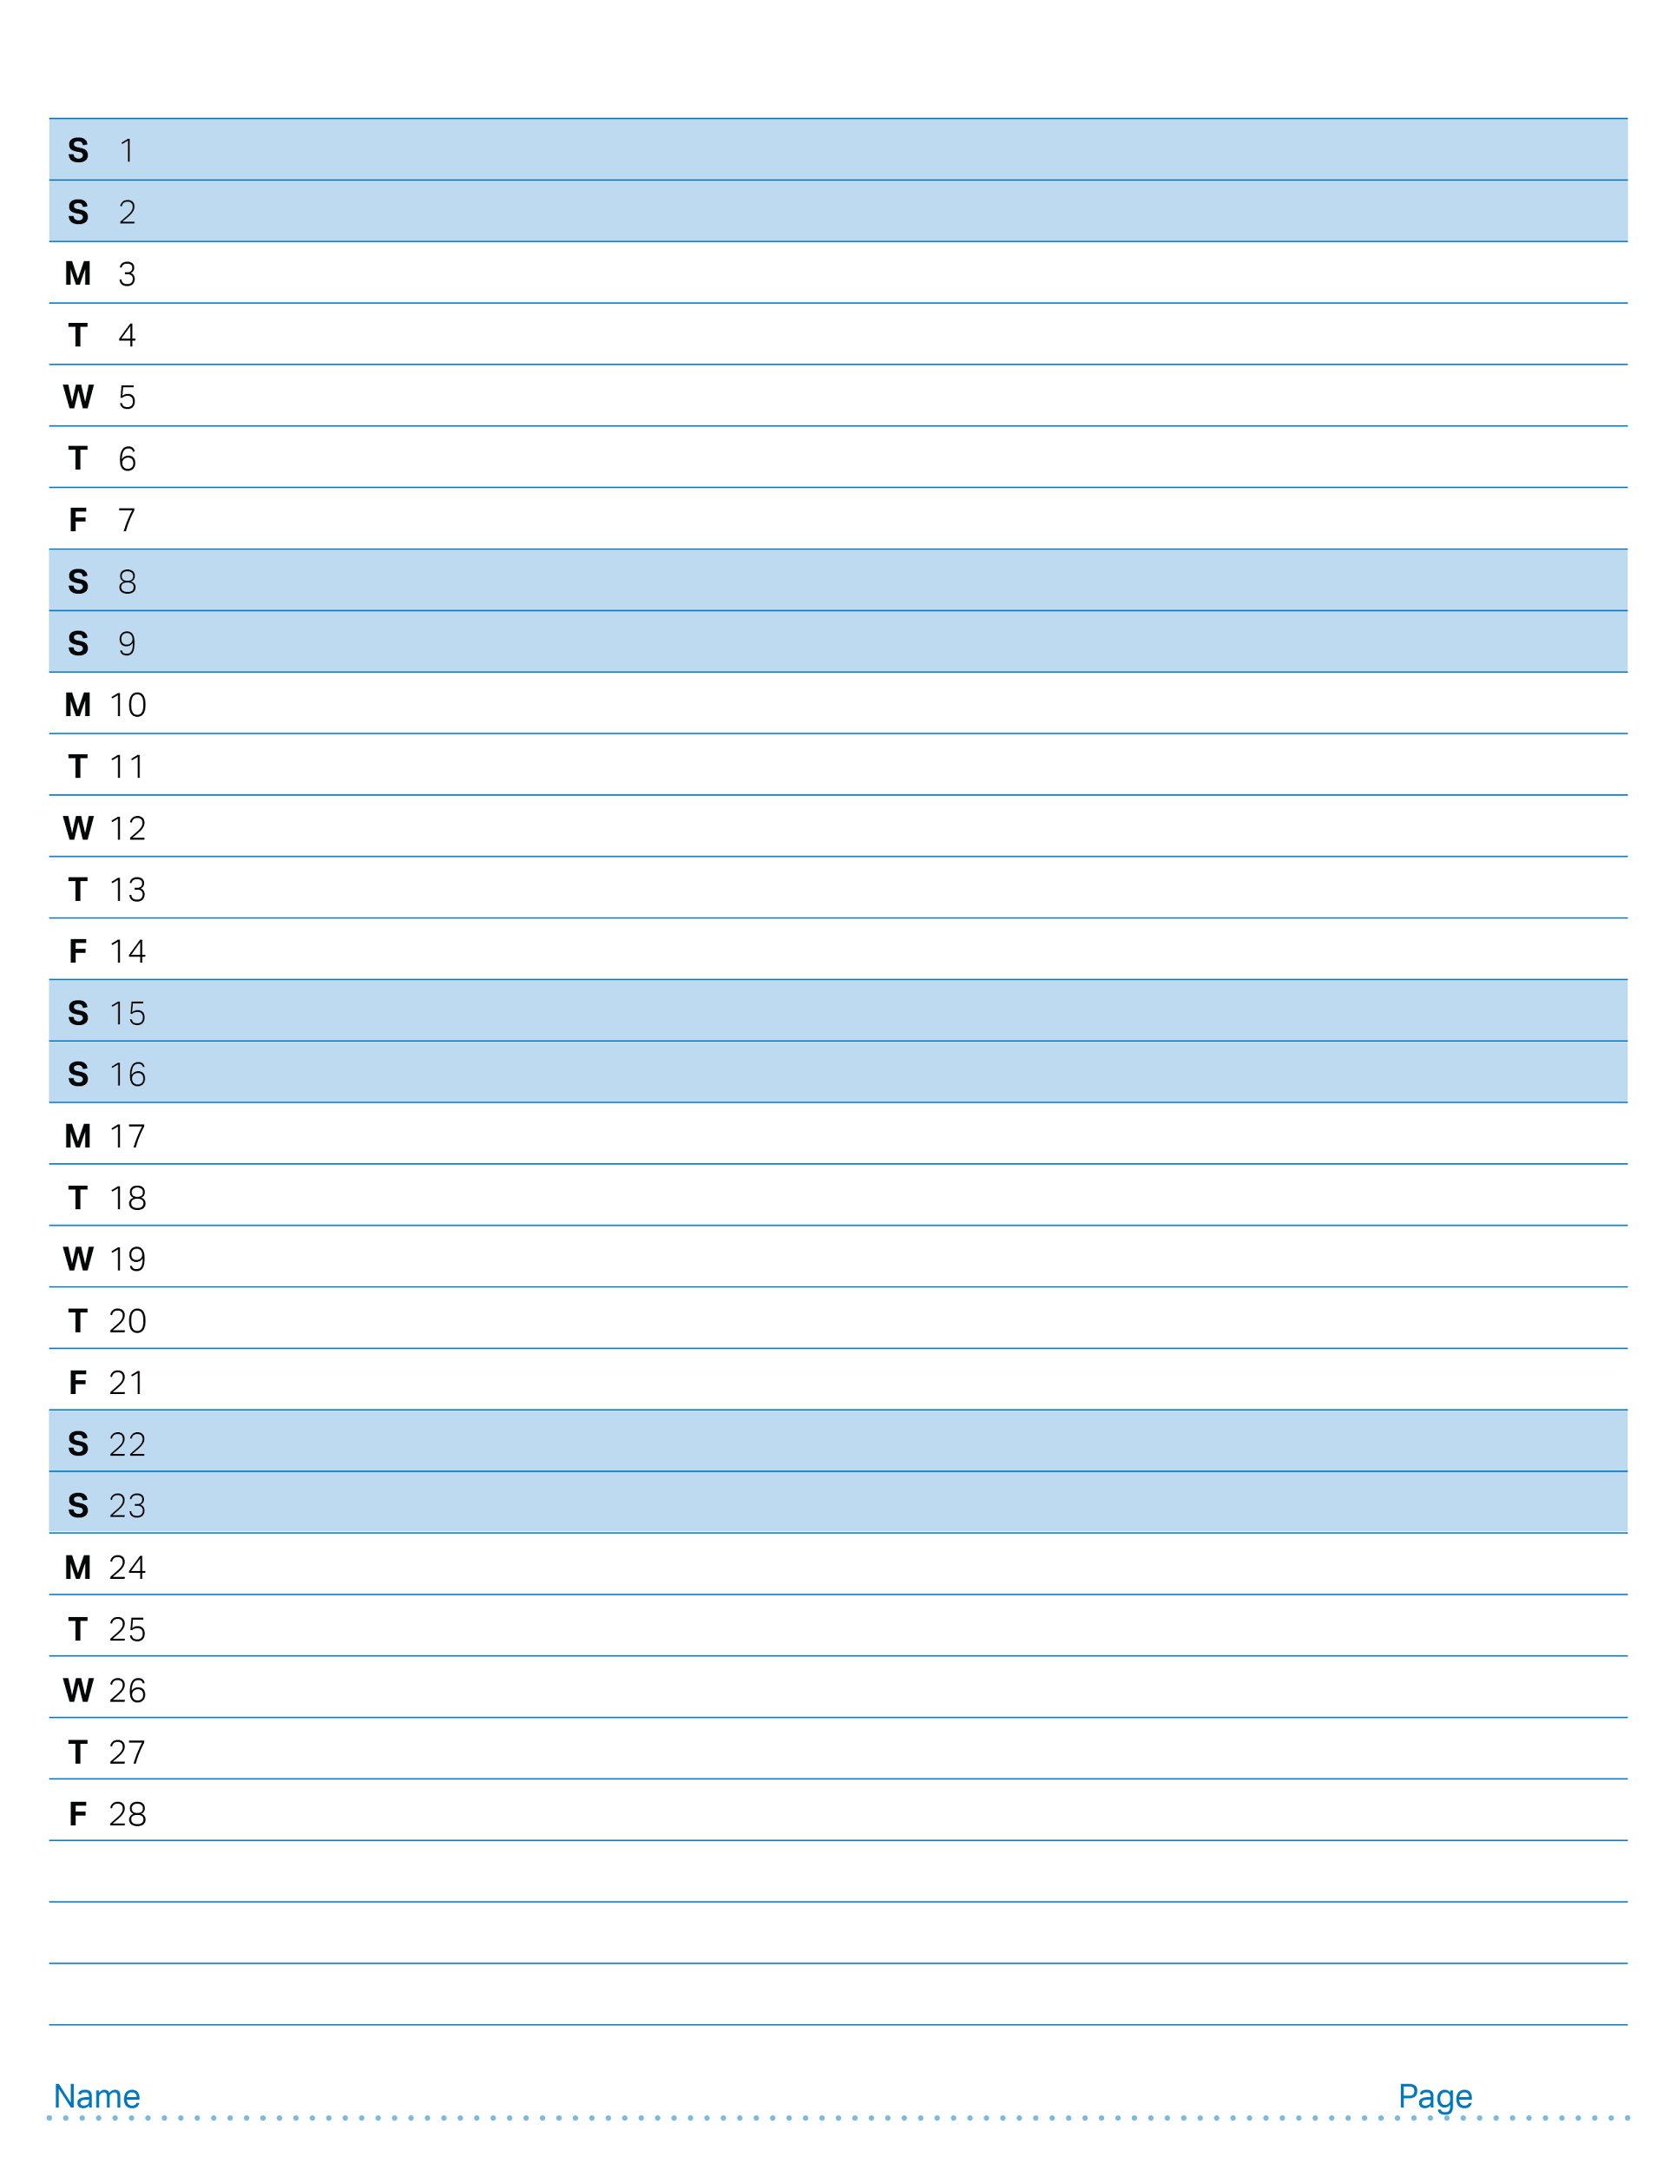
February 2025

Slide 35
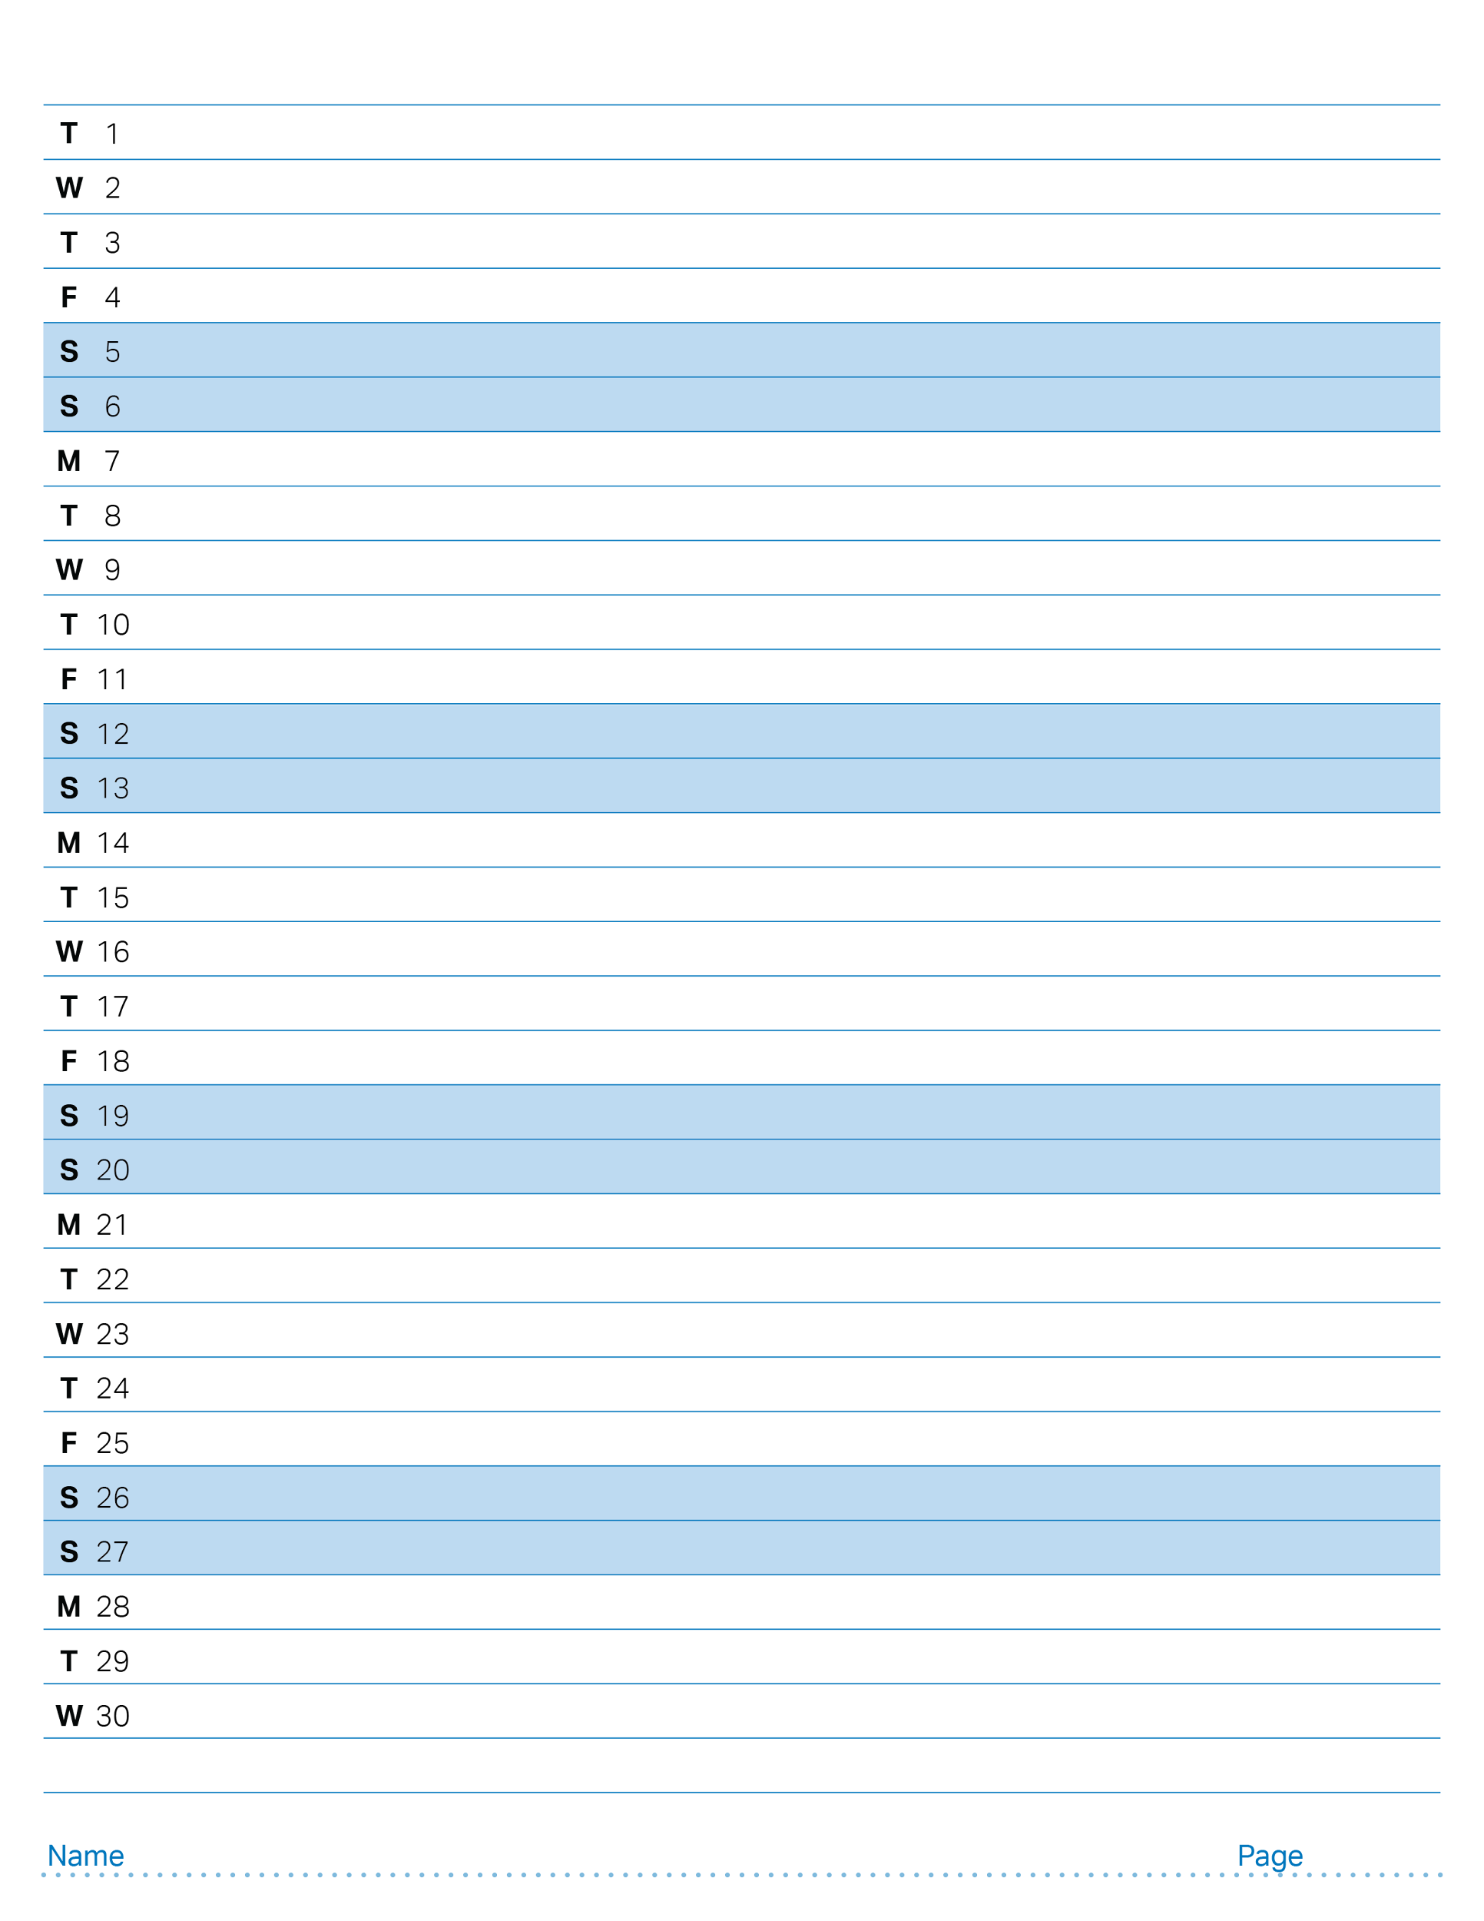
April 2025

